Slide 1

PROPOSALS
CHAPTER: 10, 12

Slide 2

Writing Activity:
Think about a time when you had a successful sales experience. It could be when you convinced someone or a group to buy something, support an idea, or participate in a project like a fundraising or community event.
Write down and share your narrative about that experience. Describe how you got yourself ready to make the sale and the people you were targeting.
Individual task
10 minutes
Not graded

Slide 3
A PROPOSAL is a persuasive document that offers a solution to an identified problem or need.
This does not include the marketing glamour, sales pitches or commercial slogans.
Proposals are written, very often collaboratively, to convince your readers to adopt an idea, a product or a service. They are for readers within the organization or for outside readers.
Proposals can be directed to:
colleagues inside your own organization (in-house proposals)
to clients outside your organization (sales proposals)
to organizations that fund research and other activities (grant proposals)
Their formats can be both formal or informal.

Slide 4
In all three cases, proposals can be presented either as a:
short and simple format (informal reports templates)
longer, more complicated format (formal proposals)
Proposals can be either:
Solicited – Requested by the reader/client
Unsolicited – Submitted to a client on your own without a request

Slide 5
Reports and Proposals help organizational decision making. They are complex documents.
Adapted to their audience and purposes. Formatted as both formal and informal.
Comparative Characteristics
Informal reports and proposals
Focus on a specific problem, situation, event
Single author usually
One to few readers
2 – 5 pages
External → letter; Internal → memo
Created per template
Headings help readers to find information
May include appendixes
Formal reports and proposals
Address complex problems, situations, events
Collaborative writing
For multiple readers of different specialities
6 – more pages
Mostly external audience
Often bound or with some (file) cover
Multiple level headings to help locate information
Have front and back material: Title page, ToC, Appendixes

Slide 6
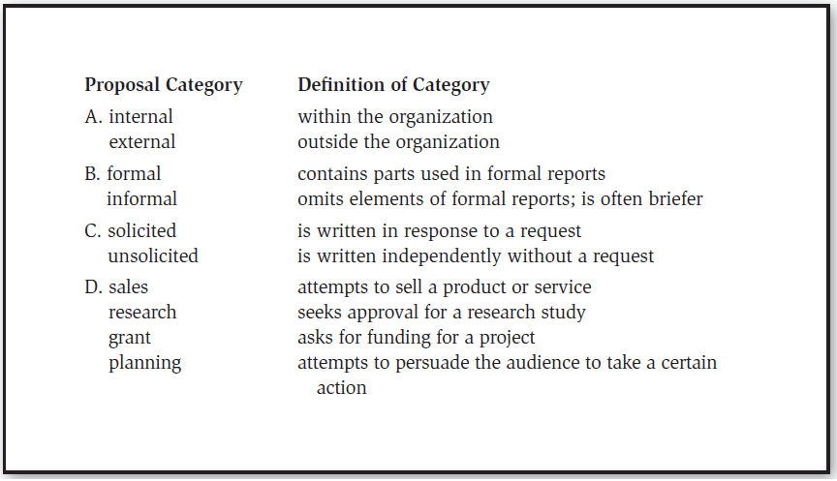
Proposals can be categorized in several ways relating to the audience and purposes

Slide 7
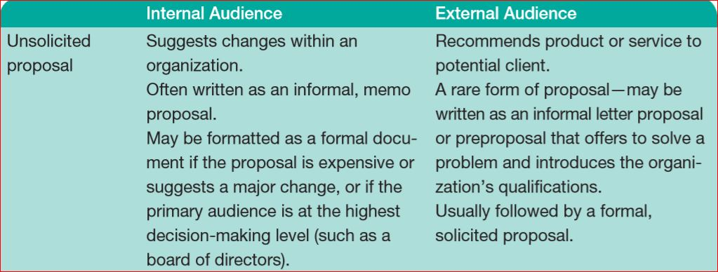
Three Basic types of Proposals

Slide 8
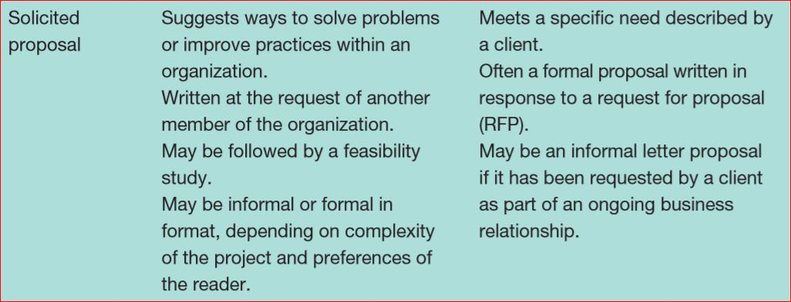
Three Basic types of Proposals (Cont’d)

Slide 9
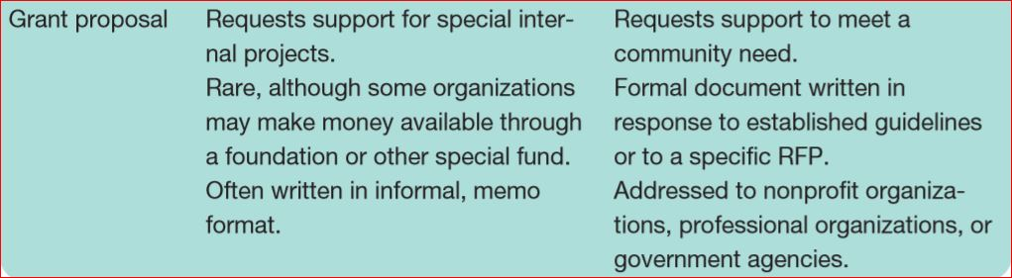
Three Basic types of Proposals (Cont’d)

Slide 10
In-house proposal for security protocol training: | James Oliver, Chief Financial Officer, has received the results of an internal audit that found problems in the way client information is being digitally secured. He asks Greg Bass, Director of Information Systems (IS), to propose changes that will improve IS security and training of all affected employees.
In-house proposal for change in purchasing practices: | Mack Boh, Facilities Maintenance Supervisor at the Baltimore branch office, writes a proposal to Brenda Seymour, Purchasing Director, suggesting that M-Global use environmentally friendly cleaning products whenever possible. The proposal describes a system for trials of products for effectiveness; each branch will use the system to develop its own list of approved products.

Slide 11
Sales proposal for dam removal project: | The Minnesota Department of Natural Resources issues a Request for Proposals for the removal of an earthen dam from a state park. The dam, built in the 1930s, is no longer safe, and it is to be removed as the first step in a river restoration project.
Grant proposal for new equipment design: | Oilarus, Ltd., a British oil company, sometimes gives research-and-development funds to small companies. Such funding usually goes toward development of new technology or products in the field of petroleum engineering. Angela Issam, who works in M-Global’s Equipment Design Lab decides to apply for funding for a research project. Her proposed project, if successful, would provide a new piece of oil-drilling safety equipment that would reduce the chance of offshore oil spills at production sites.

Slide 12
Four keys to ace in proposal and report writing skills:
1. Clearly understand your purpose – why you are writing?
2. Address the needs of the audience — what do they need?
3. Design your document per audience needs – how any solution is offered?
4. Edit carefully – the content must be error free, formal/business writings.

Slide 13
Three principles to stay organized and successful:
1. Write different parts for different readers
2. Provide the important information first
3. Repeat key points where necessary

Slide 14
Guidelines applicable to proposals, regardless of their audience or format:
1. Plan well before writing - survey the current situation, identify the best way to improve it, conduct research, collect background info, develop a plan (what you’ll need – resources, funds, equipment, expertise, benchmarks, timelines, expected benefits).
2. Make text visually appealing - Remember—you are trying to sell a product, a service, or an idea; so, get your audience onboard!
Use lists, bullets or numbered points to highlight main ideas
Follow your readers’ preferences in font size, type, line spacing, design. Proposals written in the reader-preferred format gain a competitive edge
Use headings and subheadings to break up blocks of text
Provide infographics where necessary
3. Edit Carefully – any factual or linguistic mistakes could come heavy with legal implications/ losses:
No sloppiness, no errors, clearly designed and well-written

Slide 15
A proposal is solicited or unsolicited depending on the audience’s role in its initiation.
Unsolicited proposal: A document submitted without a request to convince your readers to adopt an idea, a product, or a service.
Unsolicited proposals are usually written as informal documents and often addressed to internal audiences.
Solicited proposal: A document requested by the reader to help the reader solve a problem through the purchase of a product or a service.
Solicited proposals are usually written as formal documents and addressed to external audiences.
Request for proposal (RFP): A document sometimes sent out by an organization that wants to receive proposals for a product or some service.
The RFP gives guidelines on:
what the proposal should cover
when it should be submitted
to whom it should be sent
As writer, you should follow the RFP guidelines diligently in planning and drafting your proposal.

Slide 16
Notes:
Establishing need is crucial in unsolicited proposals, of course, when readers may not be psychologically prepared to accept a change that costs them money.

Slide 18
RFP
Flowchart showing the main documents involved in one possible project
PROPOSAL
FEASIBILTY
STUDY
Feasibility studies: documents that show the practicality of a proposed policy, product, service.
RFP (request for proposals) documents sometimes sent out by organizations wanting to receive proposals for a product or a service.
CONTRACT
PROJECT

Slide 19
Grant proposal: A document written to convince your readers to support a specific project that meets the needs of a social or professional community. Directed to organizations that fund research and other activities, grant proposals help granting organization meet their goals for improving communities.
These communities may be local, or they may be global. Grant proposals may seek to improve social conditions, or they may seek support for research to add to knowledge in a profession or to improve the quality of life for many people through improvements in specific bodies of knowledge.
Grant proposals are often written as formal documents in response to specific requests for proposal or standing grant programs. Some organizations, such as universities or government agencies, may also have internal programs that provide grants to improve services to constituents.
(Refer to Ch. 12 for detailed examples/ samples)

Slide 20
Notes:
Grant writing is an important process for nonprofit organizations and researchers
The grant-proposal writing process is similar to the process for writing proposals for a business purpose.

Slide 21
Proposal Writing Task 1:
Choose a problem at your campus for which you would consider proposing a solution. It could be operating procedures, curricula, assessments, activities, societies, residences, food, …
Identify which type of proposal you’ll write for it.
Discuss and re-evaluate the problem by:
a. Enlisting positive and negative aspects of the solution.
b. Showing how the solution(s) meets the needs of the audience or solves the problem.
4. Use the most applicable template (formal or informal) and justify it.
5. Present your ideas.
Group Work
10 minutes allowed
No submission to the instructor
One member will present
Presenter can consult draft paper

Slide 22
Proposal Writing Task 2:
Based on the content of Task 1 activity, write a proposal identifying the problem(s) and offering the possible solution(s).
Select an audience that would make decisions on your proposal.
The proposal could be either informal or formal, but it must follow the technical requirements.
It should be printed and well presented.
AI generated and plagiarized content will earn no credit.
Group work
20 marks
To be submitted to the Instructor by: _____

Slide 23
Proposal Writing Task 3:
Using the memo format develop an informal proposal for a smart home system that addresses a specific problem or need within residential environments. Your proposal should include a detailed description of the system’s architecture, hardware and software components, implementation plan, and user experience design.
In addition, provide a thorough literature review of existing smart home technologies and identify how your system improves upon current solutions.
Consider potential challenges and risks, and outline strategies for addressing them. How does your proposed system stand out from existing technologies, and what measurable benefits does it provide to users?

